Slide 1

Property Arbitrage Detector
Presented by : Sudarshan G
Sourav Kumar Sahu
Batch No : 403
INNOMATICS RESEARCH LABS,
DILSUKHNAGAR, HYDERABAD

Slide 2
Table of Contents
Introduction
Problem Statement
Library Used
Steps for Collecting Data
Collected Data
Steps for Cleaning the Data
Cleaned Data
Statistical Data
Data Visualizations
Conclusion

Slide 3
INTRODUCTIONS TO HOUSING.COM
Housing.com is a local online classifieds portal dedicated to buying, selling, and renting properties across Hyderabad. It serves a similar purpose to larger, more established platforms like 99acres, MagicBricks, No Broker, but focuses specifically on the Hyderabad real estate market.
The platform hosts listings from both authorized real estate agents and individual property owners, making it easier for users to explore apartments, independent houses, villas, commercial spaces, and open plots across various localities such as Gachibowli, Kukatpally, Madhapur, Banjara Hills, and LB Nagar.

Slide 4
PROBLEM STATEMENT
Real estate data on online platforms like Housing.com is vast but unstructured, scattered, and difficult to analyze directly.
Users, investors, and analysts struggle to obtain accurate insights into property prices, locality trends, and availability due to the lack of a centralized, clean dataset.
Hence, there is a need to collect, clean, and analyze data from Housing.com to understand pricing patterns, popular localities, and property characteristics within the Hyderabad real estate market.

Slide 5
LIBRARY USED
Pandas: For data manipulation and cleaning tasks such as handling missing values, formatting, and filtering records.
NumPy: For performing numerical operations and array manipulations.
BeautifulSoup & Requests: For web scraping property listings from Housing.com and collecting relevant property data.
Matplotlib & Seaborn: For creating visualizations like bar charts, pie charts, histograms, and scatter plots to interpret trends and insights.
re (Regular Expressions): For text extraction and data standardization, such as cleaning price formats and addresses.

Slide 6
STEPS FOR COLLECTING DATA
Defining Objectives:
The goal was to analyze property trends in Hyderabad — prices, types, and locations.
Identifying Target Locations:
Data was collected for major localities like Kondapur, Kokapet, Madhapur, Financial District, and Narsingi.
Web Scraping Setup:
Used the Requests library to send HTTP requests to Housing.com pages.
Parsed the HTML responses using BeautifulSoup to extract relevant details.

Slide 7
STEPS FOR COLLECTING DATA
Data Fields Extracted:
Property Type (Apartment, Villa, Plot, etc.)
Locality/Area
Number of Bedrooms (BHK)
Price (in INR)
Size (sq. ft.)
Furnishing Status (Furnished/Semi-Furnished/Unfurnished)
Listing Type (Owner/Agent)
Data Storage:
The scraped data was stored in a structured CSV file named hyderabad_properties.csv for further cleaning and analysis.

Slide 8
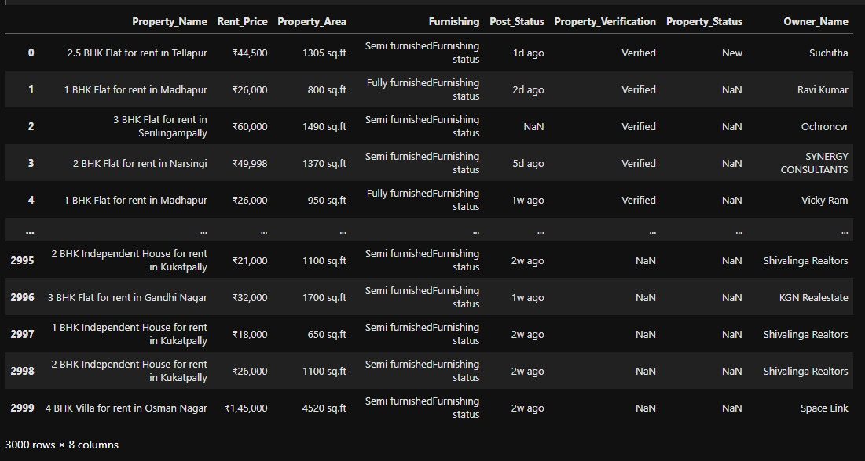
COLLECTED DATA
The raw dataset contained details of approximately 2,500+ property listings across Hyderabad.
A sample structure of the collected data is as follows:

Slide 9
STEPS FOR CLEANING THE DATA
The raw data contained missing values, inconsistent formats, and irregular text entries. The cleaning steps included:
Handling Missing Values:
  Replaced null entries in Furnishing and BHK columns with appropriate defaults (e.g., “Not Available”).
  Removed records missing key information such as Price or Location.
Standardizing Formats:
  Converted Price values from strings (e.g., "85 Lakh") to numeric values in INR.
  Ensured Size values were in consistent units (sq. ft.).
  Normalized Locality names (e.g., "Gachibowli" and "Gachi Bowli" merged).

Slide 10
STEPS FOR CLEANING THE DATA
Identified and removed duplicate listings based on a combination of Property Type, BHK, Location, and Price.
Created a new column Property_Area_In_sqft.
Added categorical encoding for Furnishing Type.
Extracted location data from Property_Name column.
Changing of data types based on the records.

Slide 11
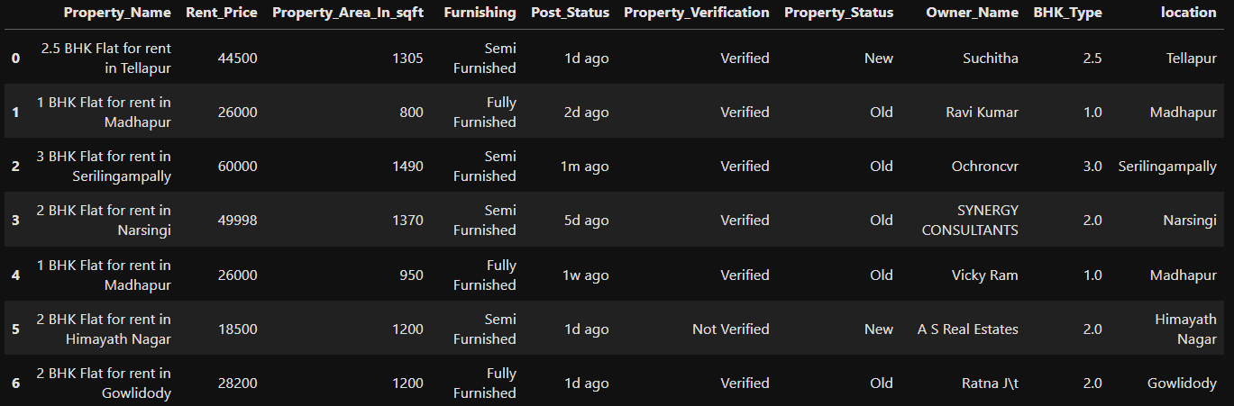
CLEANED DATA
After cleaning, the dataset looks like this :

Slide 12
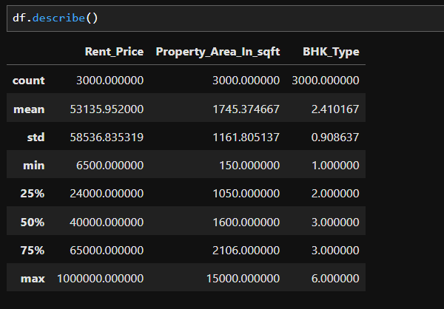
STATISTICAL DATA

Slide 13
DATA VISUALIZATIONS
Several visualizations were created to better understand the Hyderabad real estate market:
Property Type Distribution
Rent Price by Locality
Price vs Size Relationship
BHK vs Average Price
Furnishing Trends
Price per Sqft Comparison

Slide 14
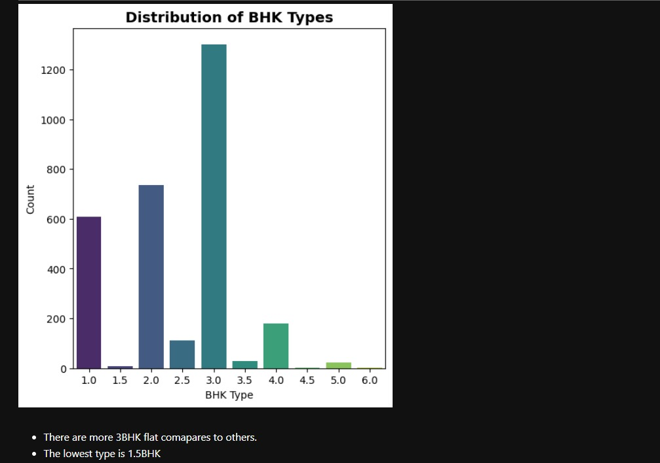
Q). Which apartment type represents the highest concentration of property?
The 3 BHK configuration is the most highly supplied segment, boasting a count exceeding 1,200 listings. The market is overwhelmingly skewed toward mid-to-large family housing units.
The 1 BHK and 2 BHK units collectively form the second-largest segment, showing strong demand but a notably lower supply compared to 3 BHKs.
Configurations above 4 BHK (4.5, 5.0, 6.0) have negligible counts. The lowest type is correctly identified as 1.5 BHK, showing a minimal supply volume.

Slide 15
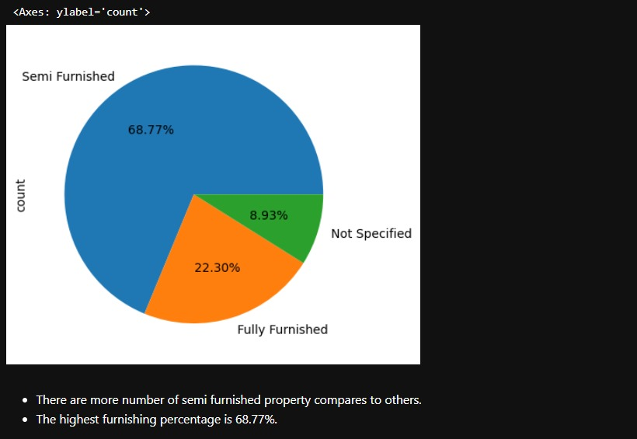
Q). What is the distribution of property furnishing types in the rental listings, and which category dominates the market?
The pie chart reveals that semi furnished properties make up the largest share of the rental market, accounting for 68.77% of all listings.
Fully furnished properties represent 22.3%, indicating a significant but much smaller segment compared to semi furnished options.
Only 8.93% of the listings do not specify their furnishing status, showing that most property advertisements provide this detail.image.jpg​
Overall, renters are most likely to encounter semi furnished options when searching for apartments, making it the prevalent standard in the current market.

Slide 16
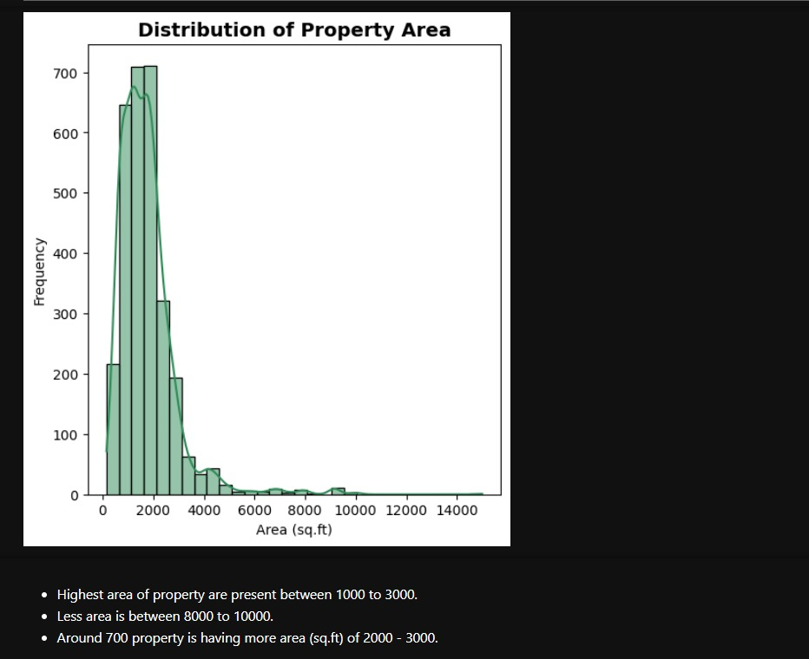
Q). What size properties do we have the most of, and how does that affect what we can charge?
The market exhibits an extreme right-skewed distribution, with the vast majority of rental properties falling within the 1,000 to 3,000 sq.ft. range (The peak of the distribution).
The analysis shows the highest frequency (around 700 properties) is concentrated in the peak segment (approximately 2,000 sq.ft.). This volume establishes the baseline rental rate for the entire market.
Less than 5% of the total supply is found in the large-format luxury bracket (above 6,000 sq.ft.), indicating extremely low liquidity.

Slide 17
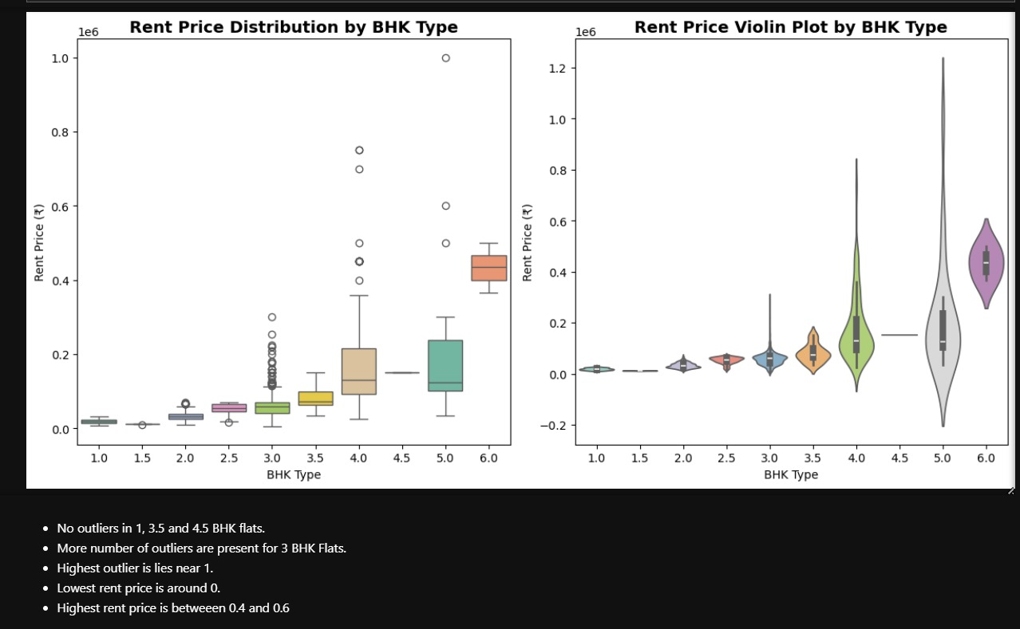
Q). What does the distribution and variation of rent prices look like across different BHK types, and which BHK category exhibits the largest spread or outliers in rental values?
The box plot and violin plot together clearly illustrate how rent prices vary by BHK type, with higher BHK types generally showing wider ranges and higher median rent values.
3 BHK flats have the most outliers, indicating significant variability and extreme rents in this segment; in contrast, 1, 3.5, and 4.5 BHK flats show no significant outliers, suggesting more stable pricing for those categories.
The lowest rent prices are close to ₹0 for all types, while the highest outlier approaches ₹1,000,000 (or 10 lakh rupees), observed especially for larger BHK categories.

Slide 18
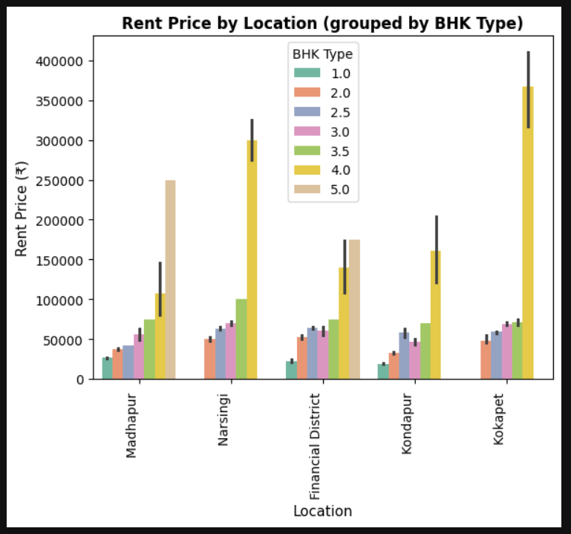
Q). Which locations show the most dramatic price premium for larger, luxury apartments (4.0 BHK and 5.0 BHK)
Kokapet and Narsingi stand out for having the highest average rental prices, particularly for larger units. The 5.0 BHK apartments in Kokapet have an average rent exceeding ₹350,000, which is the highest average price point shown on the chart.
The Financial District also commands a high price for 4.0 and 5.0 BHKs, indicating its strength in the premium/luxury residential segment, likely targeting high-salaried professionals.
Madhapur and Kondapur appear to be the most accessible areas for smaller units. Madhapur's 1.0 and 2.0 BHKs are among the lowest-priced options.

Slide 19
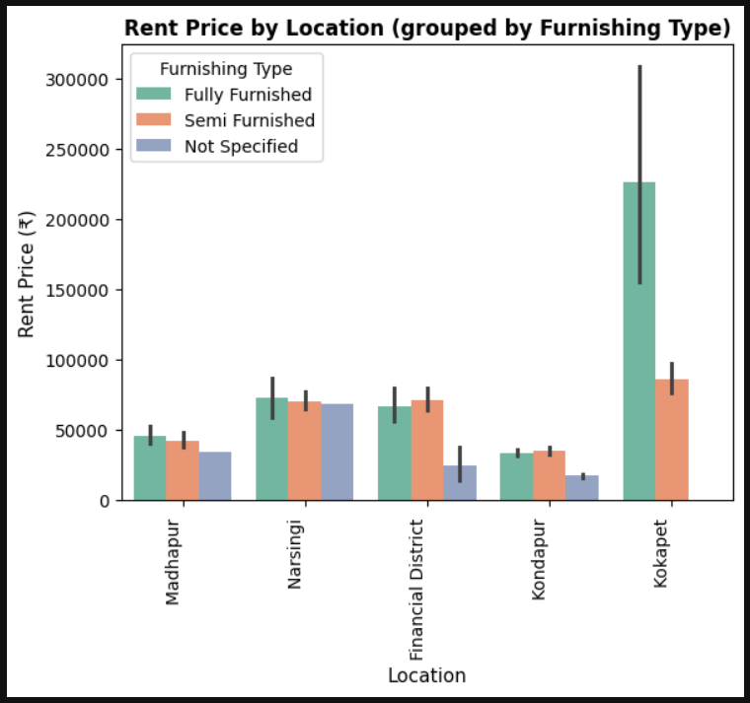
Q). In which high-demand locality does a 'Fully Furnished' property command the largest premium, and does the 'Semi Furnished' standard hold the highest rent price across all analyzed areas?
Kokapet shows an exceptional premium for the Fully Furnished category, with a rent price exceeding ₹225,000. This is the highest price point and shows the most significant gap between Fully and Semi Furnished options.
In most core localities like Narsingi, Madhapur, and Financial District, the Semi Furnished and Fully Furnished rent prices are surprisingly close. In Narsingi, the average for both is around ₹70,000.
The Not Specified category in Narsingi and Financial District has a high price point (around ₹70,000), likely because these are new, high-value apartments that haven't finalized the furnishing status, or the furnishing details were not scraped cleanly.

Slide 20
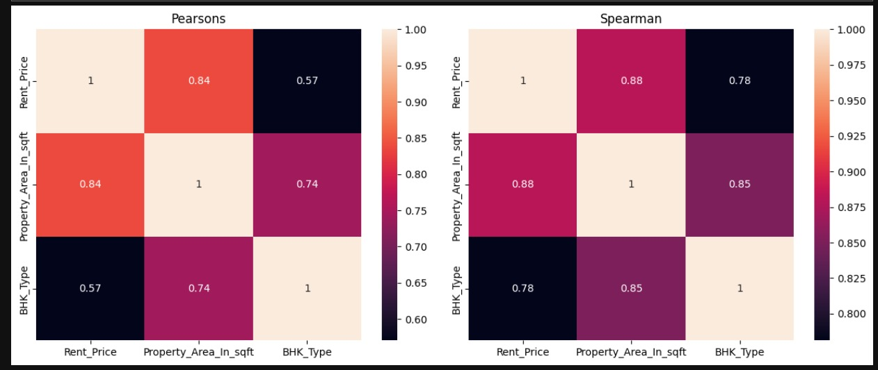
Q). How strongly are rent price, property area in square feet, and BHK type correlated in the dataset, and does the relationship differ when measured using Pearson versus Spearman correlation?
All features are positively correlated, meaning an increase in one (like property area or BHK type) is generally associated with a rise in rent price.
The Pearson correlations (which measure linear relationships) indicate that rent price is very strongly related to property area (0.84) and moderately to BHK type (0.57).
The Spearman correlations (which are better for ranking and non-linear relationships) are even higher, at 0.88 for rent price vs. property area, and 0.78 for rent price vs. BHK type.

Slide 21
SOLUTION
To address this issue, we developed a web scraping and exploratory data analysis (EDA) pipeline that:
Scrapes property listings (price, area, location, BHK, property type, etc.) from Housing.com for Hyderabad.
Cleans and preprocesses the data to handle duplicates, missing values, and inconsistent formats.
Performs exploratory data analysis to identify:
Presents findings through interactive visualizations, enabling data-driven decision-making for buyers, sellers, and market analysts.

Slide 22
CONCLUSION
Market Insights:
Apartments dominate the Hyderabad housing market, followed by plots and villas.
Premium areas like Kokapet and Narsingi have the highest price based on BHK Type.
Kondapur and Madhapur offer relatively affordable options with a wide range of apartments only based on 2BHK properties.
Practical Applications:
This analysis can guide buyers, sellers, and investors in identifying high-value and high-demand areas.
Real estate agents can use the insights for pricing strategies and targeted marketing.

Slide 23

THANK
YOU

